Slide 1

ULTIMATE FIGHTING CHAMPIONSHIP

Slide 2
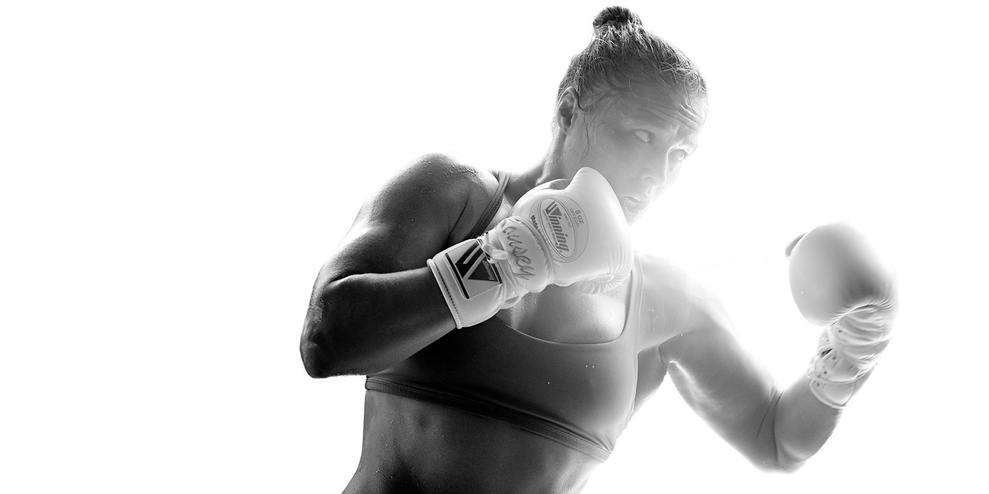
About
The dataset contains a list of every UFC fight in the history of the organisation from 1913 to 2019.
Every row contains information about both fighters, fight details and winners.
Our project aim is to visualize, analyse and generate hypothesis based on this data..
.

Slide 3
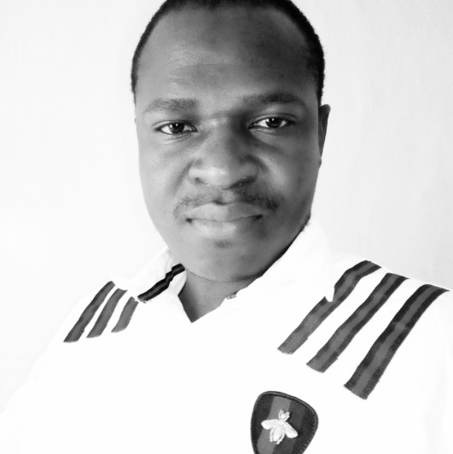
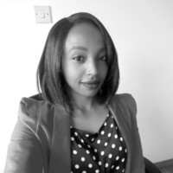
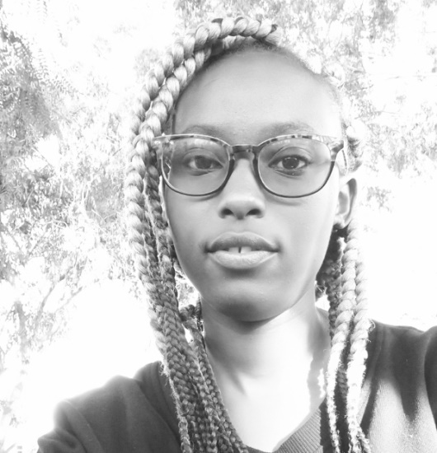
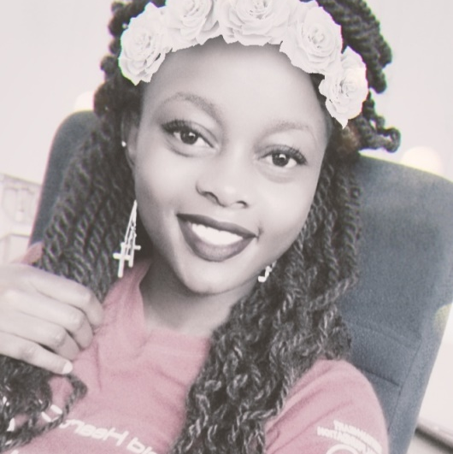
Meet Our Team
ABEL KIYA
LEAH MBUGUA
ANN MACHARIA
VIVIAN NJAU
Team Lead
Analysis & Presentation
Tableau & Analysis
Report & Analysis

Slide 4






Tools Used

Slide 5
Diagram Layout
STEP 2
STEP 3
Exploratory Data Analysis.
Sampling Techniques.
Simple Random Sampling.
STEP 1
STEP 4
Tableau analysis through visualizations.
Hypothesis Testing.

Slide 6
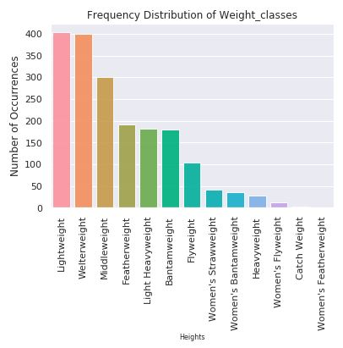
ABOUT OUR MISSION

Slide 7
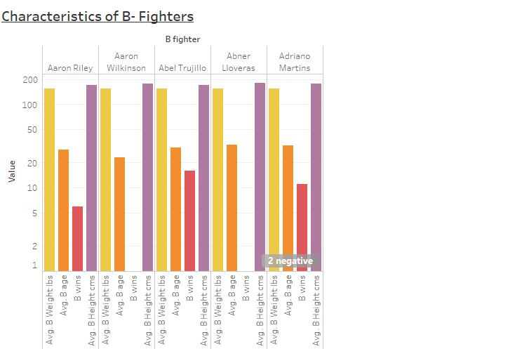
ABOUT OUR MISSION

Slide 8
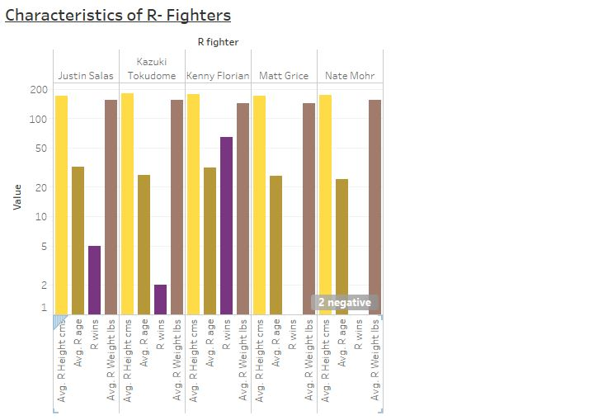
ABOUT OUR MISSION

Slide 9
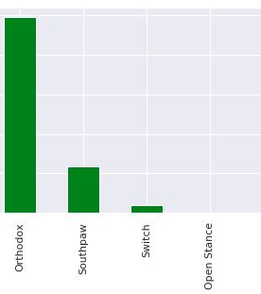
Univariate Analysis
The orthodox stance is the most used. This could imply that most of the players are right handed.

Slide 10
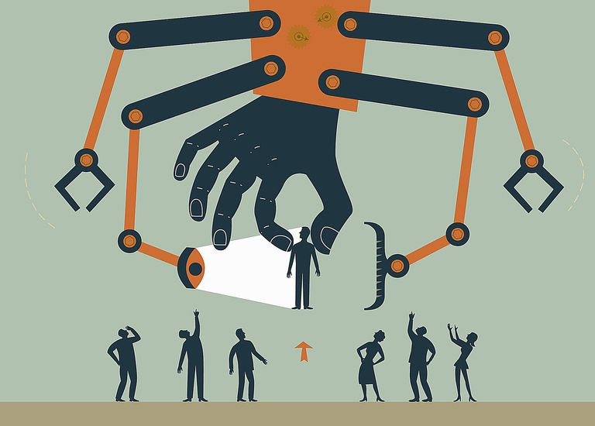
Purposive Sampling
This is a type of non-probability sampling that is used when one relies on their judgement when choosing a subset of data from a whole population to be used in analysis.

Slide 11

Hypothesis Testing
Null hypothesis.
Ho: The average Body Mass index of UFC lightweight players is 25.1.
Ho: Uo = 21.5
Alternative hypothesis.
H1: The average Body Mass index of UFC lightweight players is not 25.1.
Ho: U1 != 21.5
.

Slide 12

Interpretation
The null hypothesis is rejected when:
P-Value < significance level.
In this research the P-Value is less than the alpha level
i.e. 0.0 < 0.05.
In this case we reject the null hypothesis and conclude that:
The average Body Mass index of UFC lightweight players is not 25.1.
.

Slide 13

Questions?

